Slide 1
Rehab Driving Simulator
Geoff Colman
Jackson Myers

Slide 2
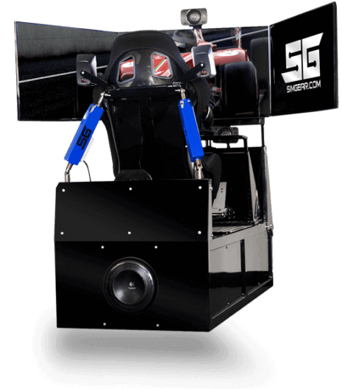
What is our project?
Custom hardware controller, user interface, and data-gathering software for out-of-the-box driving simulator to be used by people recovering from strokes and brain injuries
Driving simulator hardware is provided by Prof. Smith’s Mechanical Engineering team

Slide 3

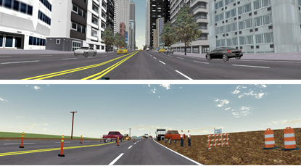
What is our project?
Open-source simulator tools will be utilized and modified
Prof. Smith is in the process of choosing what software to use
Simulator manufacturer will provide assistance with hardware controllers

Slide 4
What is our project?
Prof. Smith will run experiments using both injured and able-bodied participants
The goal is to demonstrate therapeutic effectiveness, guide future treatment

Slide 5
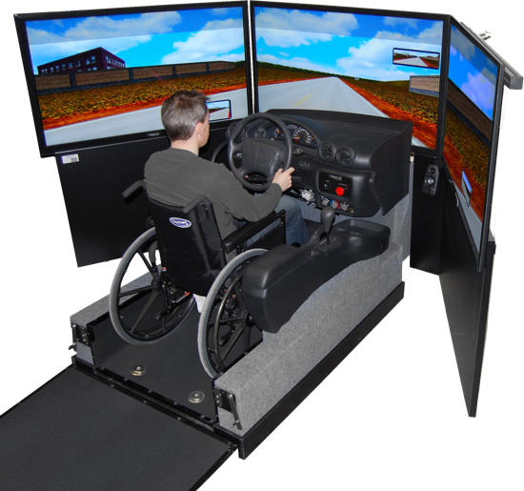
Why is this interesting?
Conventional therapeutic simulators don’t provide motion feedback
Full motion feedback in commercial simulators can be too stressful for patients
Also a valuable research tool in aiding long-term development of therapies and strategies

Slide 6
Our Roles
We will be handling a commercial video game code base
This project requires us to modify system code for the simulator hardware as well as the game software
Our most central goal is providing realistic, but limited, feedback to the driver

